Slide 1
Chapter 22 Database Recovery Techniques

Slide 2
Recovery Concepts
Recovery Outline and Categorization of Recovery Algorithms
Recovery from transaction failures:
the database is restored to the most recent consistent state before the time of failure.
The system keeps information about the changes that were applied to data items by the various transactions in the system log.
In case of failure, Just recover the committed transactions as uncommitted transactions doesn’t modify database. So, they will be rolled back

Slide 3
Recovery Concepts
Recovery Outline and Categorization of Recovery Algorithms
CATASTROPHIC FAILURE:
Extensive damage to database because of disk crash,
Solution:
restores a past copy of the db. from some archival storage
and redo the operations of committed transactions from the log file up to failure point to ensure Database consistency.

Slide 4
Recovery Concepts
Recovery Outline and Categorization of Recovery Algorithms
NON-CATASTROPHIC FAILURE:
When the database on disk is not physically damaged,
the recovery strategy is to identify any changes that may cause an inconsistency in the database.
For example,
A transaction has not yet committed and is failed,
Then it is possible that some of its write operations are done and some are left.
So all the operations needs to be undone
And redo for the whole transaction is required to ensure atomicity & data consistency

Slide 5
Recovery Concepts
Recovery Outline and Categorization of Recovery Algorithms
Recovery from non-Catastrophic failure:
Conceptually, we can define 2 policies for recovery from non-catastrophic failures:
Deferred update
Immediate update

Slide 6
Recovery Concepts
Recovery Outline and Categorization of Recovery Algorithms
Deferred update techniques:
Do not update the database on disk before COMMIT operation
Before COMMIT,
all changes done by the transactions are saved in local workspace or the Main memory buffers.
all the updates operations are recorded in log file, once COMMIT is done, all the updates are written to database

Slide 7
Recovery Concepts
Recovery Outline and Categorization of Recovery Algorithms
Deferred update techniques:
In case of transaction failure:
No need to UNDO the changes done by the transaction as the changes were done locally
Just REDO of the operations is required as the changes were not written to database yet.
That’s why Deferred update is also known as the
NO-UNDO/REDO algorithm.

Slide 8
Recovery Concepts
Recovery Outline and Categorization of Recovery Algorithms
Deferred update techniques:
Example: (Log For Deferred Update)
<start_Transaction,T1>
<read_item,T1,A>
<write_item,T1,A,10>
<commit, T1>
Note: here, we don’t need to store outdated value of data item because in this case we never undo any operation

Slide 9
Recovery Concepts
Recovery Outline and Categorization of Recovery Algorithms
Immediate update technique:
The database is updated by some operations of a transaction before reaching the COMMIT point
i.e., Writing in main memory and disk side by side without waiting for COMMIT operation
All operations are forcefully written in log file before COMMIT to make recovery possible.
If a transaction fails after some operations but before COMMIT
the effect of its operations on the database must be undone.
This technique, known as the UNDO/REDO algorithm, requires both operations during recovery

Slide 10
Recovery Concepts
Recovery Outline and Categorization of Recovery Algorithms:
Immediate update technique
Example: (Log For ImmediateUpdate)
<start_Transaction,T1>
<read_item,T1,A>
<write_item,T1,A,10,11>
<commit, T1>
Note: here, we store old and new values of data item

Slide 11
Recovery Concepts
Caching (Buffering) of Disk Blocks
For recovery purposes, buffering of disk blocks is done in DBMS cache
DBMS cache:
Collection of in-memory buffers.
A directory for the cache is maintained to track which database items are in the buffers.
Directory is a table that saves entries as:
<Disk_page_address,Buffer_location, … >

Slide 12
Recovery Concepts
Caching (Buffering) of Disk Blocks
Whenever, DBMS requests some item:
cache directory is checked whether the requested item is in DBMS cache or not.
If it is not, the item must be located on disk, So the appropriate disk pages are copied into the cache.
If DBMS cache is already filled?
cache buffers needed to be replaced to make space available for the new item

Slide 13
Recovery Concepts
Caching (Buffering) of Disk Blocks
The entries in DBMS cache Dictionary:
Holds additional info. For buffer management
Dirty bit
pin-unpin bit

Slide 14
Recovery Concepts
Caching (Buffering) of Disk Blocks
The entries in DBMS cache Dictionary:
Dirty bit:
Associated with each buffer in the cache
included in the directory entry
to indicate whether or not the buffer has been modified.
Dirty bit = 0 :
page is first read from the database disk into a cache buffer,
a new entry is inserted in the cache directory with the new disk page address.
Dirty bit = 1 :
As soon as the buffer is modified.
Data needs to be written to disk when the buffer contents are replaced from the cache

Slide 15
Recovery Concepts
Caching (Buffering) of Disk Blocks
Pin-unpin bit:
page in the cache is pinned (bit value 1) if it cannot be written back to disk as yet.
Why?
Because the recovery protocol may restrict certain buffer pages from being written back to the disk until the transactions that changed this buffer have committed.

Slide 16
Recovery Concepts
Caching (Buffering) of Disk Blocks
Strategies for replacing cache buffers
In-place updating
Writes the buffer to the same original disk location
Overwrites old values of any changed data items
Shadowing
Writes an updated buffer at a different disk location, to maintain multiple versions of data items
Not typically used in practice

Slide 17
Recovery Concepts
Caching (Buffering) of Disk Blocks
Before-image(BFIM):
old value of data item before updating
After-image(AFIM):
new value of data item after updating

Slide 18
Recovery Concepts
Write-Ahead Logging, Steal/No-Steal, and Force/No-Force
REDO-type log entry includes the new value (AFIM) of the item written by the operation since this is needed to redo the effect of the operation from the log.
UNDO-type log entries include the old value (BFIM) of the item since this is needed to undo the effect of the operation from the log.
In an UNDO/REDO algorithm, both BFIM and AFIM are recorded into a single log entry.

Slide 19
Recovery Concepts
Write-Ahead Logging, Steal/No-Steal, and Force/No-Force
DBMS cache holds the cached database disk blocks in main memory buffers.
When an update to a data block—stored in the DBMS cache—is made, an associated log record is written to the log buffer in the DBMS cache.
Write-ahead logging approach: the log buffers (blocks) that contain the associated log records for a particular data block update must first be written to disk before the data block itself can be written back to disk from its main memory buffer.

Slide 20
Recovery Concepts
Write-Ahead Logging, Steal/No-Steal, and Force/No-Force
No-steal approach: a cache buffer page updated by a transaction cannot be written to disk before the transaction commits.
UNDO will never be needed during recovery, since a committed transaction will not have any of its updates on disk before it commits.
pin-unpin bit will be set to 1 (pin) to indicate that a cache buffer cannot be written back to disk.
Steal: the recovery protocol allows writing an updated buffer before the transaction commits.

Slide 21
Recovery Concepts
Write-Ahead Logging, Steal/No-Steal, and Force/No-Force
Force approach: If all pages updated by a transaction are immediately written to disk before the transaction commits.
REDO will never be needed during recovery, since any committed transaction will have all its updates on disk before it is committed.
Otherwise, it is called no-force.
For frequently changed objects, a no-force policy reduces the number of write operations to the on-disk database object.

Slide 22
Recovery Concepts
Write-Ahead Logging, Steal/No-Steal, and Force/No-Force
The deferred update (NO-UNDO) recovery scheme follows a no-steal approach.
Typical database systems employ a steal/no-force (UNDO/REDO) strategy.
The advantage of steal is that it avoids the need for a very large buffer space to store all updated pages in memory.
The advantage of no-force is that an updated page of a committed transaction may still be in the buffer when another transaction needs to update it.

Slide 23
Recovery Concepts
Write-Ahead Logging, Steal/No-Steal, and Force/No-Force
Write-ahead logging (WAL) protocol for a recovery algorithm that requires both UNDO and REDO:
The before image of an item cannot be overwritten by its after image in the database on disk until all UNDO-type log entries for the updating transaction have been force-written to disk.
The commit operation of a transaction cannot be completed until all the REDO-type and UNDO-type log records for that transaction have been force written to disk.

Slide 24
Recovery Concepts
Checkpoints in the System Log and Fuzzy Checkpointing
Another type of entry in the system log is called a checkpoint.
A checkpoint is written in log file as :
[checkpoint, list of active transactions]
When system writes the modified DBMS buffers on disk, then this checkpoint entry is inserted into system log
All transactions that have their [commit, T] entries in the log before a [checkpoint] entry
do not need to have their WRITE operations redone in case of a system crash,
since all their updates will be recorded in the database on disk during checkpointing.
List of active transactions from checkpoint entry will help in identifying transactions for recovery.

Slide 25
Recovery Concepts
Checkpoints in the System Log and Fuzzy Checkpointing
The DB recovery manager will decide at what time the checkpoint is taken.
The interval for checkpoints can be decided in terms of :
time (i.e., after every 4 minutes) or
after the number of committed transactions since the last checkpoint (i.e., after every 4 transactions’ commit)

Slide 26
Recovery Concepts
Checkpoints in the System Log and Fuzzy Checkpointing
Taking a check point involves following actions:
Suspend execution of transactions temporarily.
Force-write all main memory buffers that have been modified to disk.
Write a [checkpoint] record to the log, and force-write the log to disk.
Resume executing transactions.

Slide 27
Recovery Concepts
Checkpoints in the System Log and Fuzzy Checkpointing
The cost of writing modified buffers back to disk (i.e., step 2) will induce delay in currently executing transactions as they are at halt state.
That’s why fuzzy checkpointing is used.
Fuzzy checkpointing.
The system can resume transaction processing after a [begin_checkpoint] record is written to the log without having to wait for step 2 to finish.
When step 2 is completed, an [end_checkpoint, … ] record is written in the log with the relevant information collected during checkpointing

Slide 28
Recovery Concepts
Transaction Rollback and Cascading Rollback
If a transaction fails for some reason after updating the database, but before the transaction commits,
it may be necessary to roll back the transaction.
If any data item values have been changed by the transaction and written to the database on disk,
they must be restored to their previous values (BFIMs).
The undo-type log entries are used to restore the old values of data items that must be rolled back.
Because they contains both old and new values

Slide 29
Recovery Concepts
Transaction Rollback and Cascading Rollback
cascading rollback:
If a transaction T is rolled back, any transaction S that has read the value of some data item X written by T ,must also be rolled back.
Similarly, once S is rolled back, any transaction R that has read the value of some data item Y written by S must also be rolled back; and so on.
it can occur when the recovery protocol ensures recoverable schedules but does not ensure strict or cascadeless schedules.

Slide 30
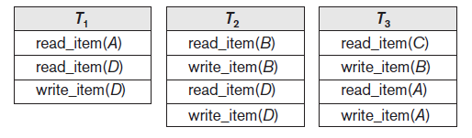
Recovery Concepts
Transaction Rollback &
Cascading Rollback

Slide 31
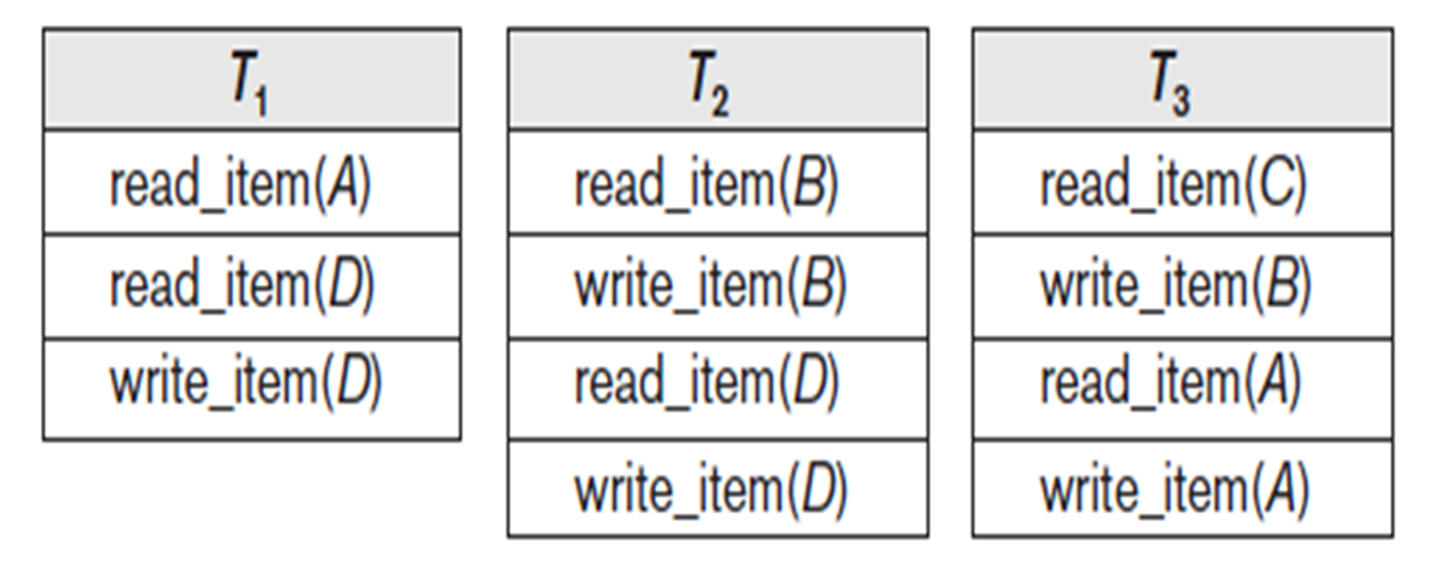
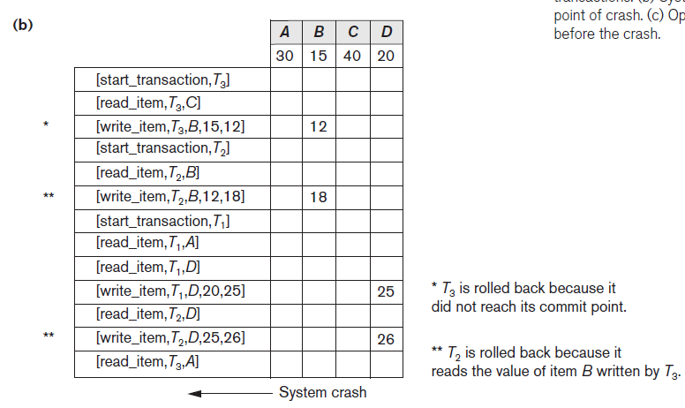
Recovery Concepts

Slide 32
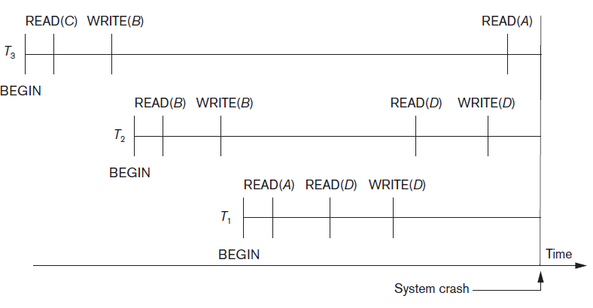
Recovery Concepts
Transaction Rollback and Cascading Rollback

Slide 33
Recovery Concepts
Transaction Rollback and Cascading Rollback
We must now check for cascading rollback.
T2 reads the value of item B that was written by transaction T3.
Because T3 is rolled back, T2 must now be
rolled back, too.
The WRITE operations of T2, marked by ** in the log, are the one that are undone.
Note that only write_item operations need to be undone during transaction rollback; read_item operations are recorded in the log only to determine whether cascading rollback of additional transactions is necessary.

